Slide 1


Slide 2

What are deep neural networks?

Slide 3

Why would having many layers be beneficial?
No one knows?
Or it just works

Slide 4
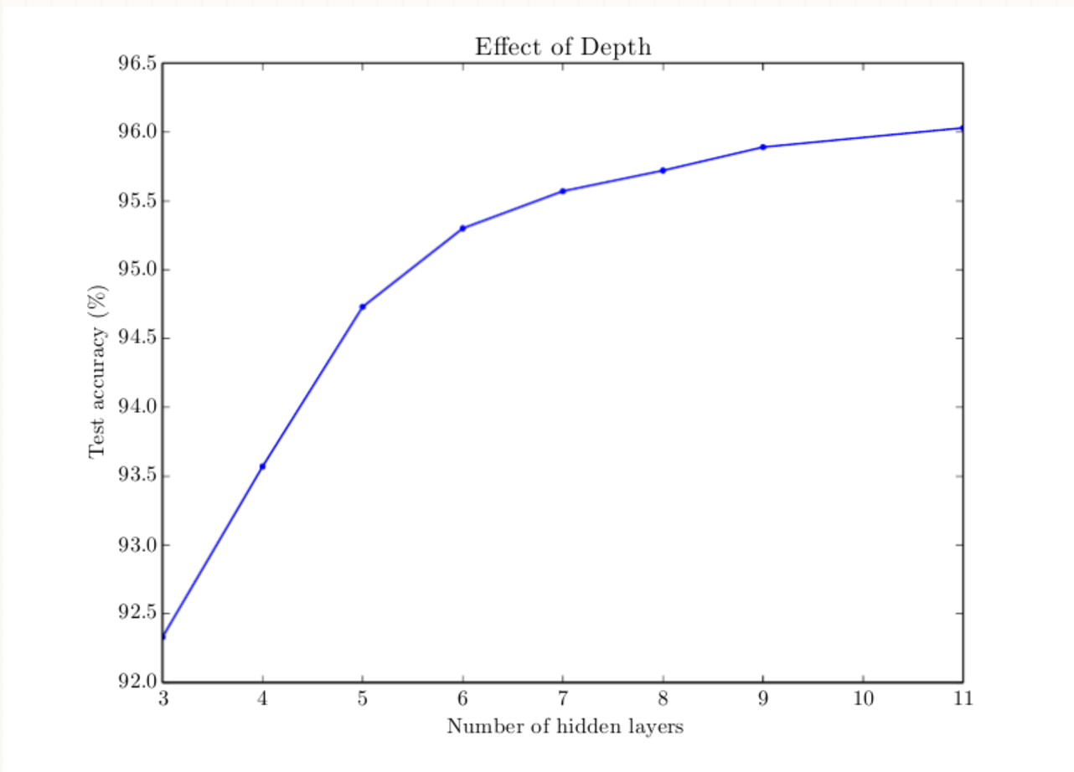
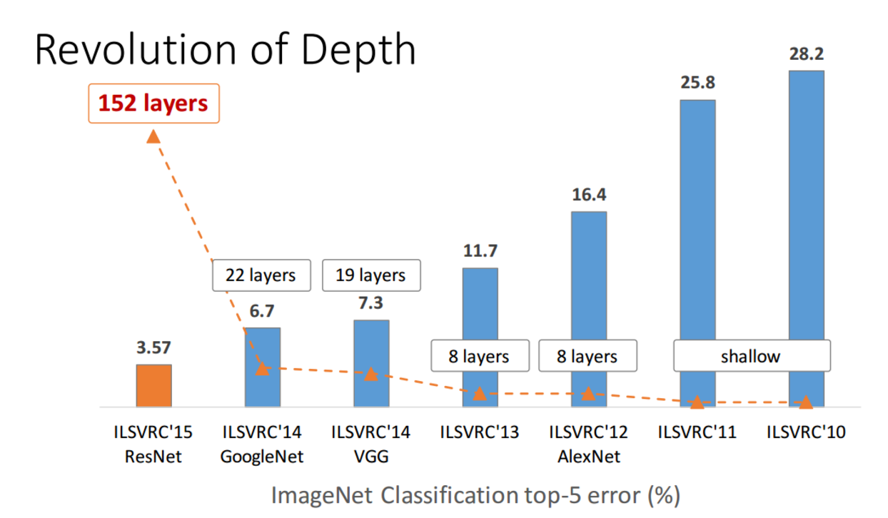
Examples

Slide 5
May be because ?
Maybe a shallow network would need more neurons then the deep one?
Maybe a shallow network is more difficult to train with our current algorithms (e.g. it has more nasty local minima, or the convergence rate is slower, or whatever)?
Maybe a shallow architecture does not fit to the kind of problems we are usually trying to solve (e.g. object recognition is a quintessential "deep", hierarchical process)?
Something else?
Experts argue in favour of 1 and 3

Slide 6
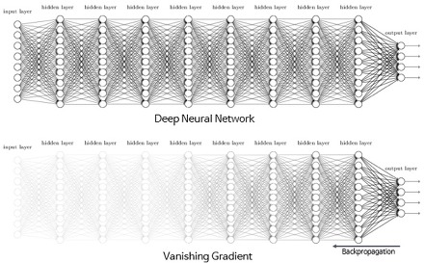
Vanishing and exploding gradients problem in DNN
Notes:
Gradients often get smaller and smaller as the algorithm progresses down to the lower layers. As a result, the Gradient Descent update leaves the lower layer connection weights virtually unchanged, and training never converges to a good solution. This is called the vanishing gradients problem. In some cases, the opposite can happen: the gradients can grow bigger and bigger, so many layers get insanely large weight updates and the algorithm diverges. This is the exploding gradients problem,which occurs in recurrent neural networks

Slide 7
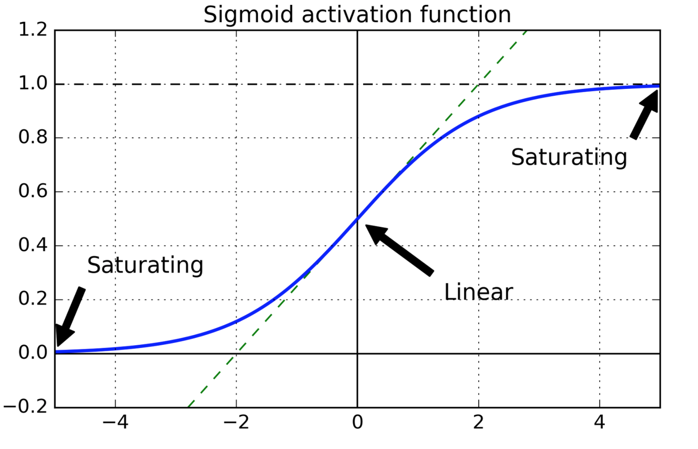
What was the problem?
Initialization scheme and activation function were the culprits
http://goo.gl/1rhAef

Slide 8
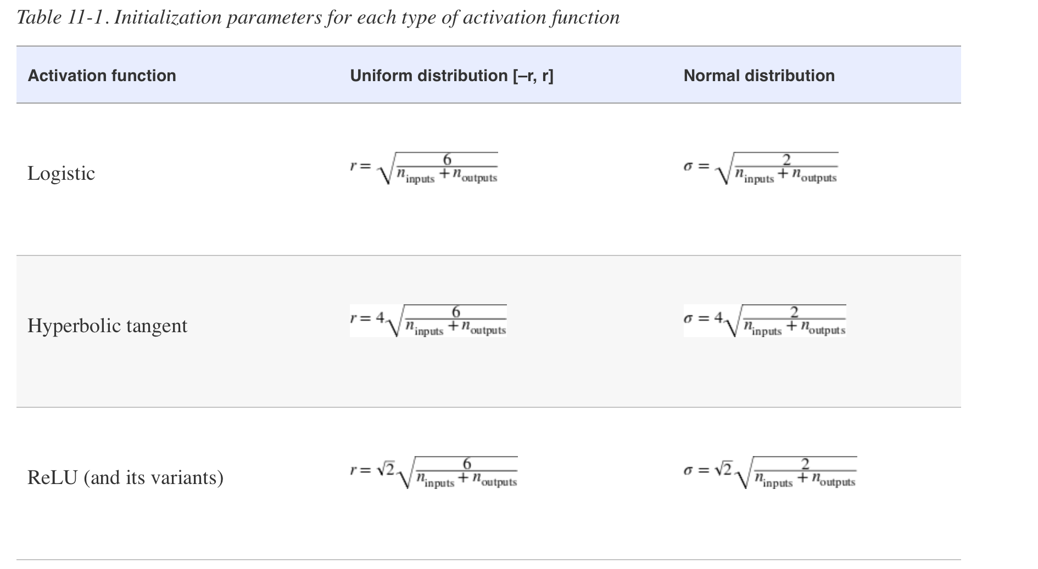
Initialization parameters for each type of activation function

Slide 9
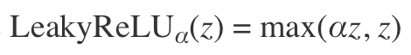
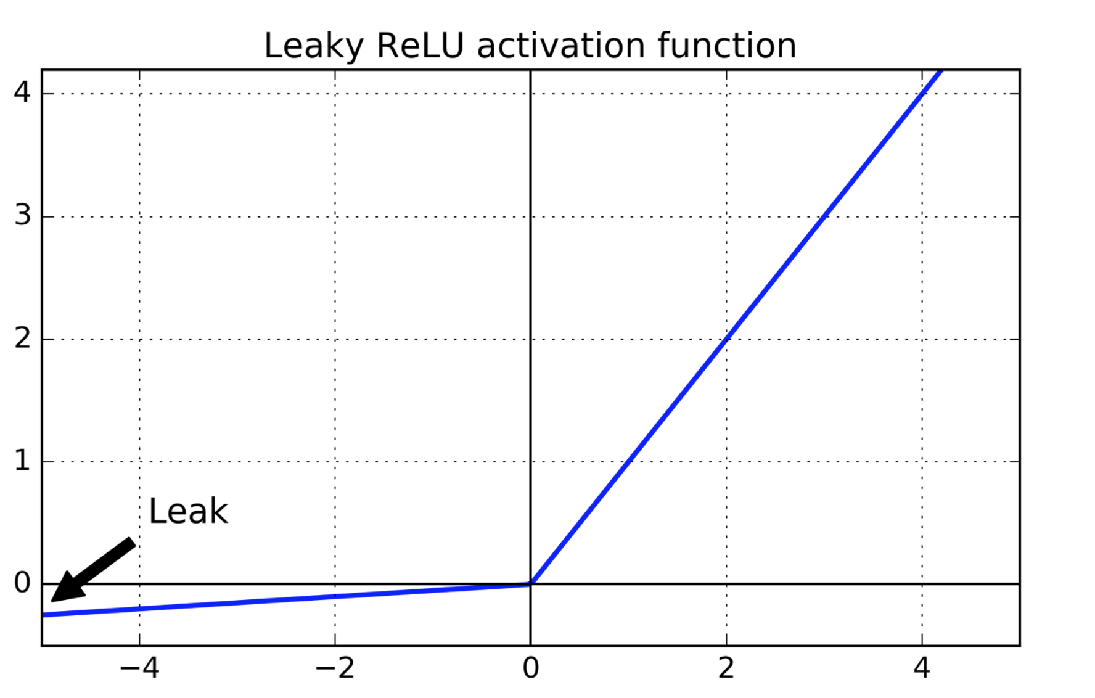
Better activation functions
Relu is better than sigmoid activation function but not best – Dying neurons problem

Slide 10
Better activation functions
Relu is better than sigmoid activation function but not best – Dying neurons problem

Slide 11
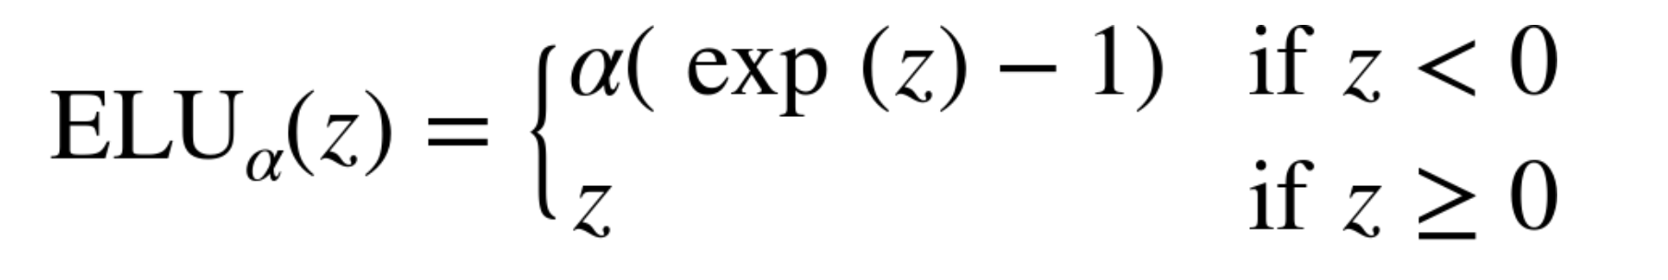
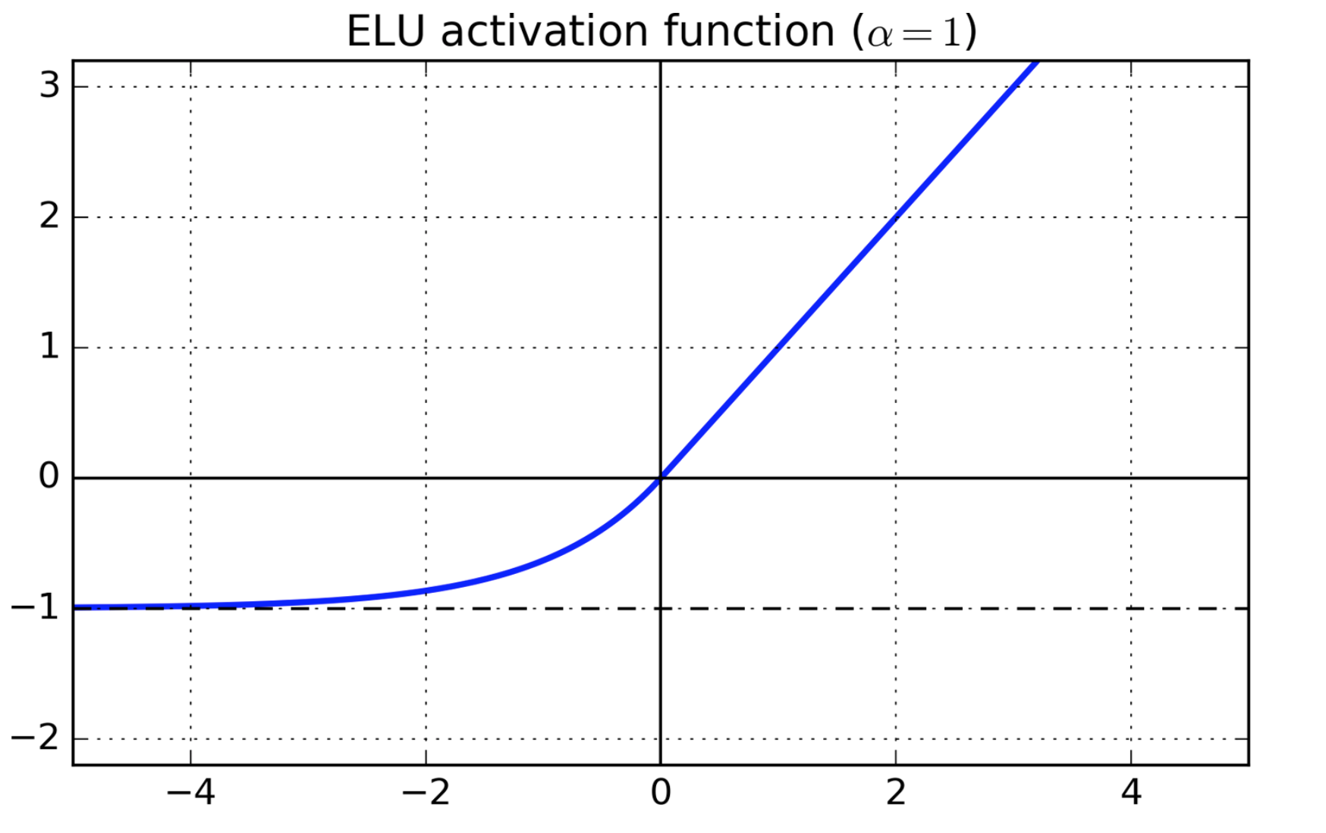
Better activation function

Slide 12
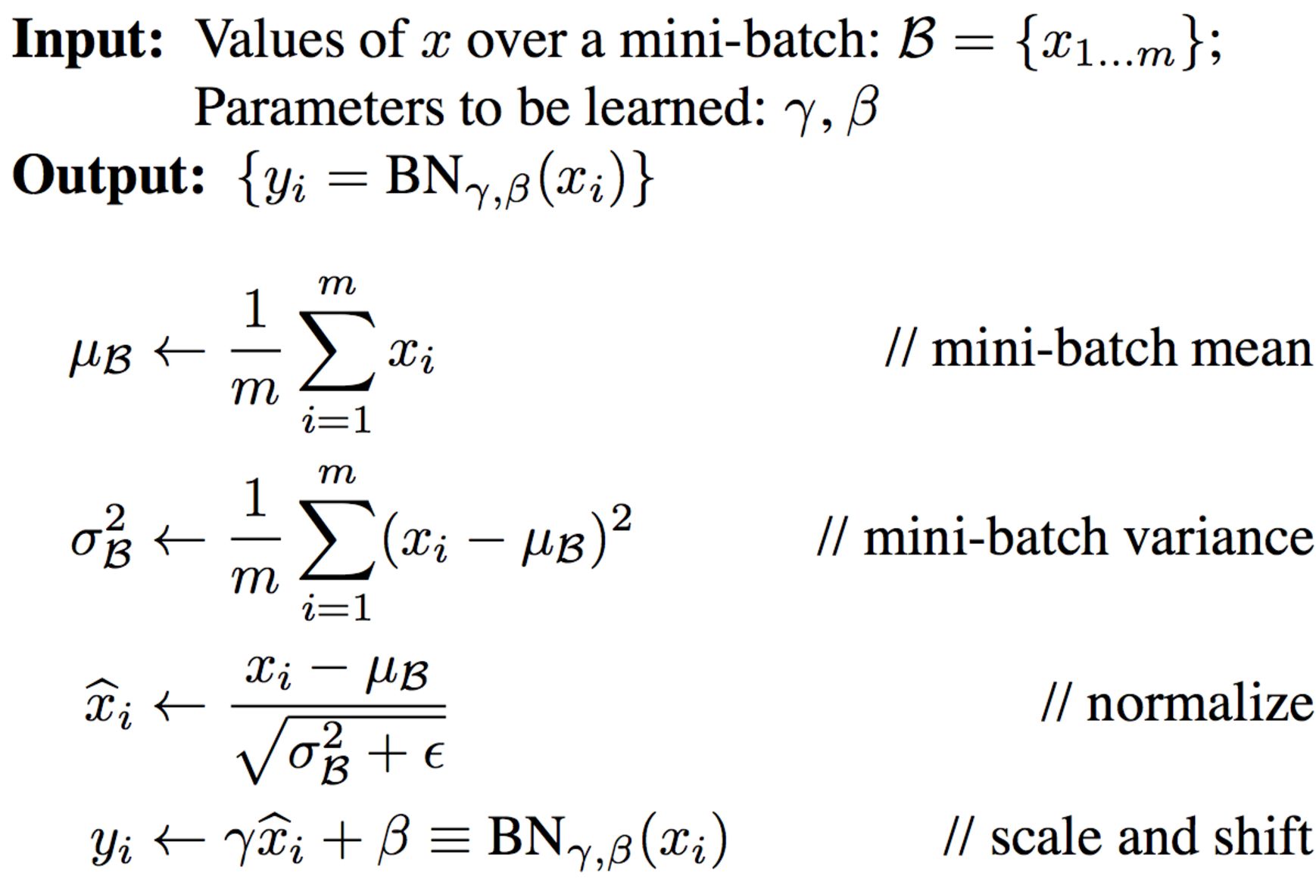
Batch normalization over initialization/activation functions
Notes:
Talk about gradient clipping

Slide 13
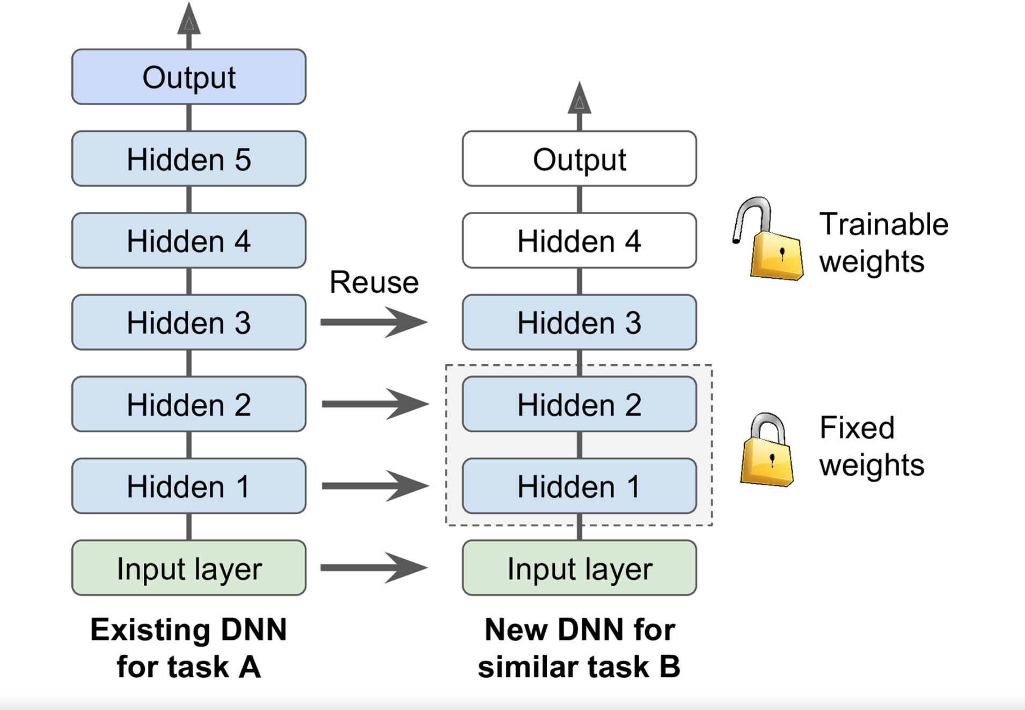
Transfer Learning
Notes:
More generally, transfer learning will only work well if the inputs have similar low-level features

Slide 14
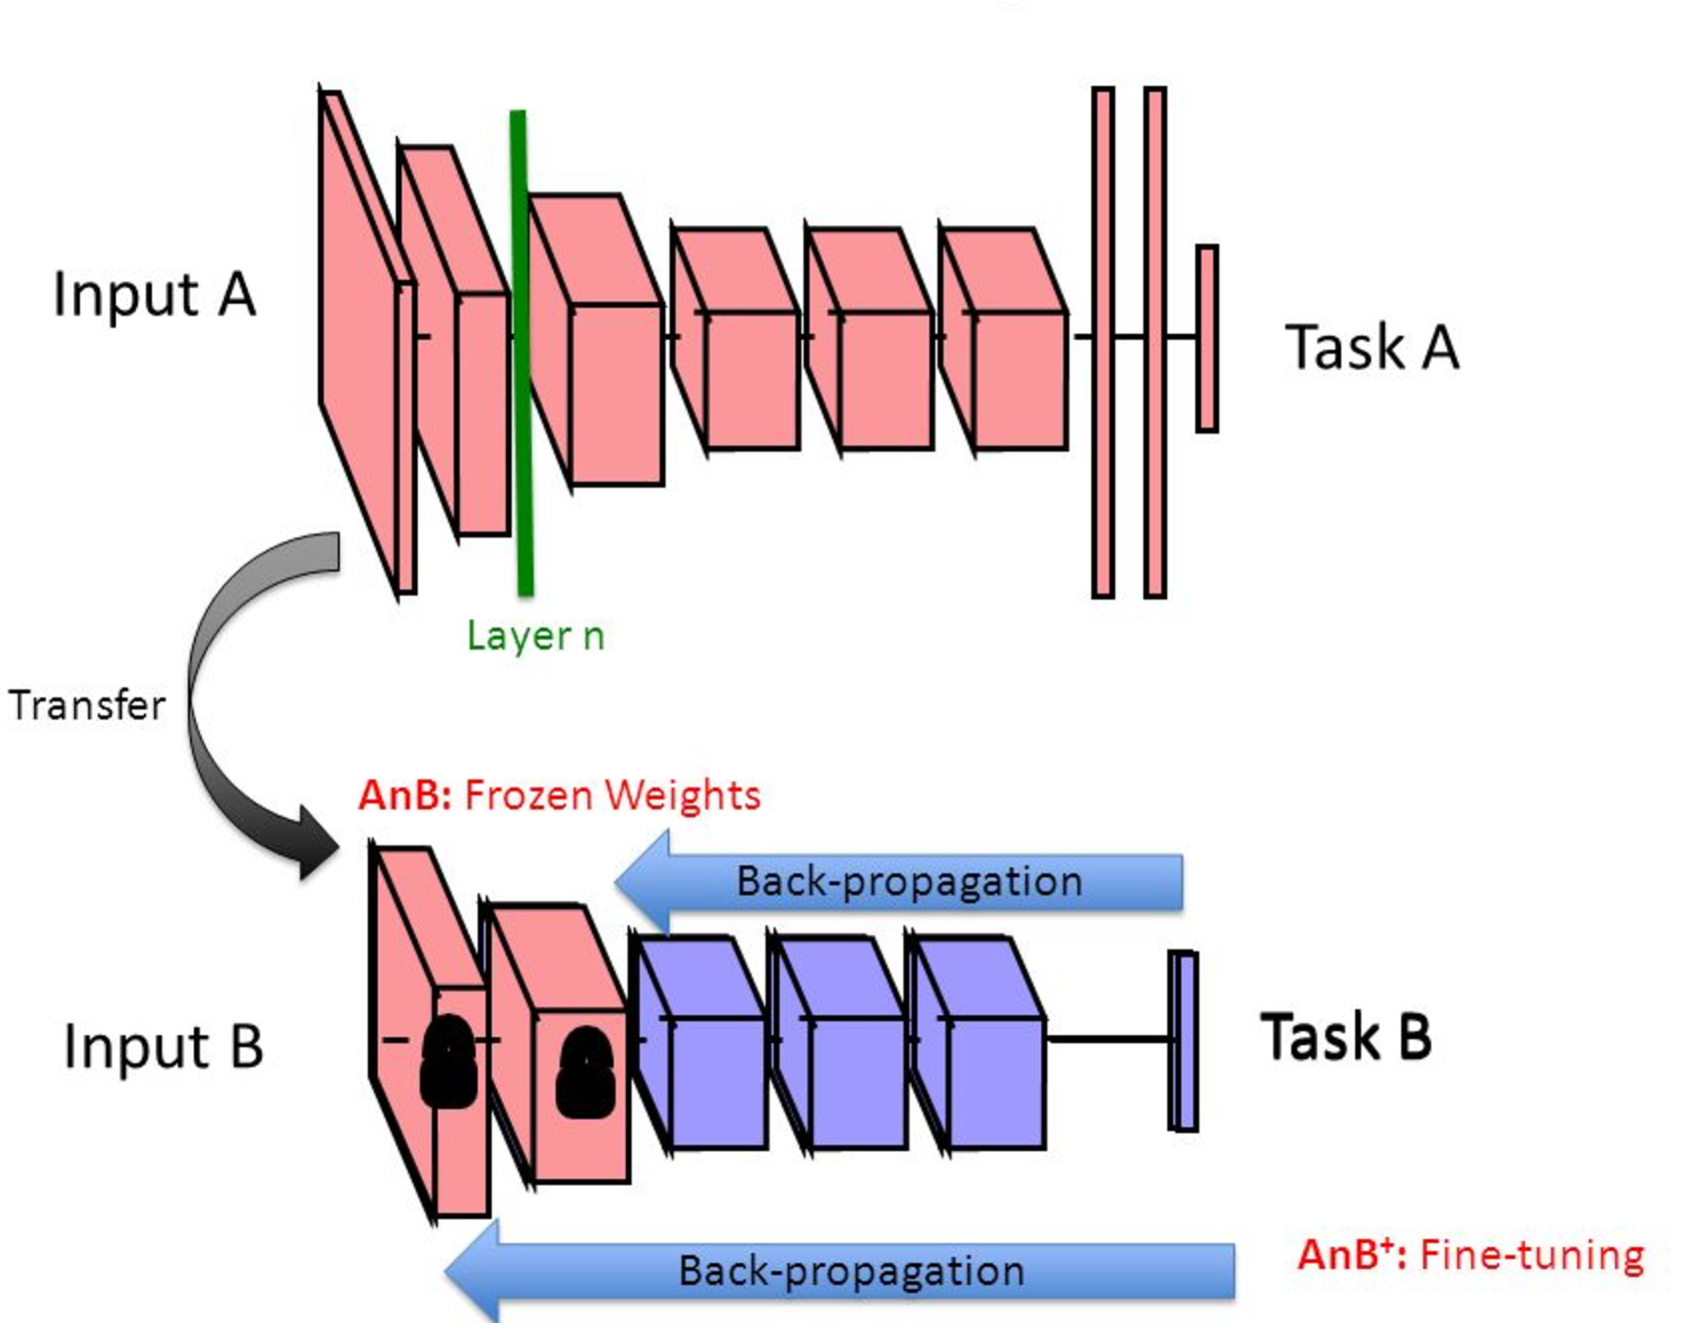
Transfer Learning
Notes:
More generally, transfer learning will only work well if the inputs have similar low-level features

Slide 15
Better Optimizers
Momentum optimization, Nesterov Accelerated Gradient, AdaGrad, RMSProp, and finally Adam optimization.
Notes:
More generally, transfer learning will only work well if the inputs have similar low-level features

Slide 16
How to avoid overfitting?
Early stopping
L1/L2 Regularization
Drop out of neurons
Max Norm Regularization
Notes:
One way to implement this with TensorFlow is to evaluate the model on a validation set at regular intervals (e.g., every 50 steps), and save a “winner” snapshot if it outperforms previous “winner” snapshots. Count the number of steps since the last “winner” snapshot was saved, and interrupt training when this number reaches some limit (e.g., 2,000 steps). Then restore the last “winner” snapshot.
you can use ℓ₁ and ℓ₂ regularization to constrain a neural network’s connection weights (but typically not its biases).

Slide 17
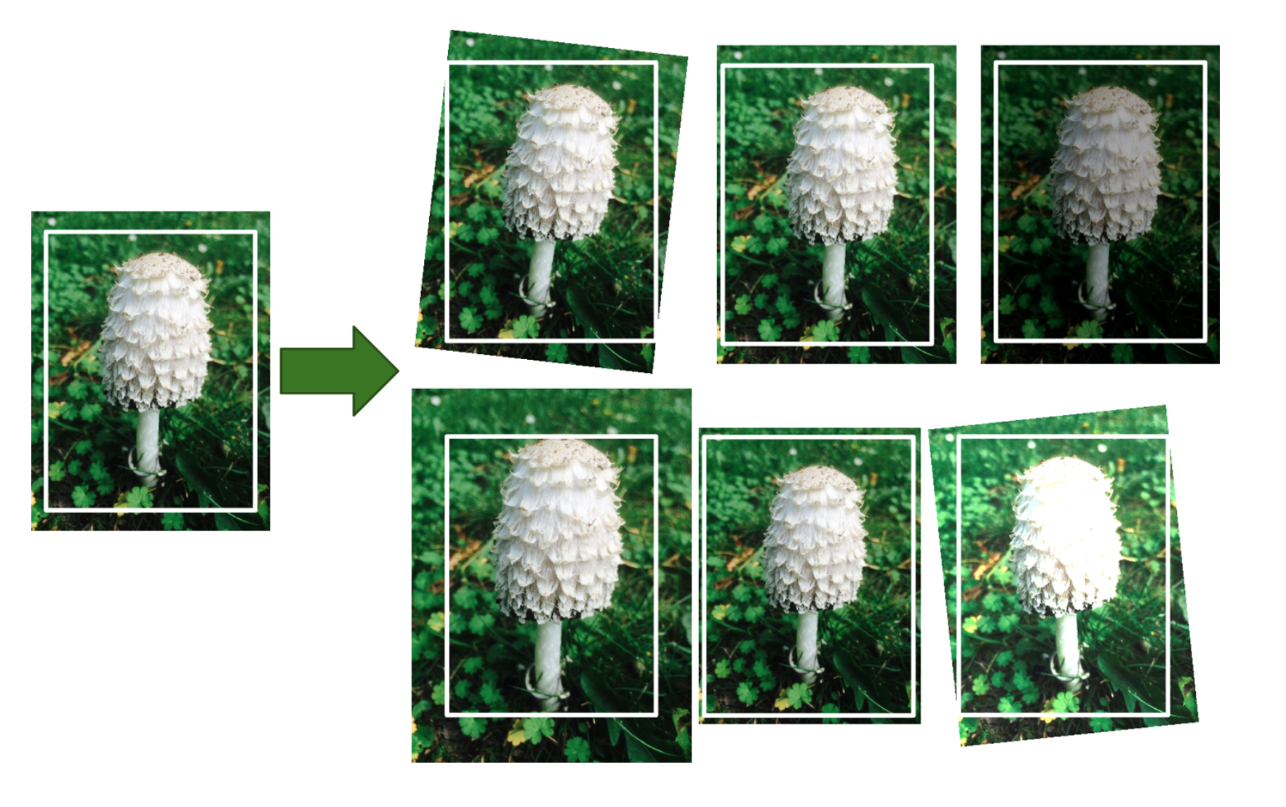
Data augmentation

Slide 18
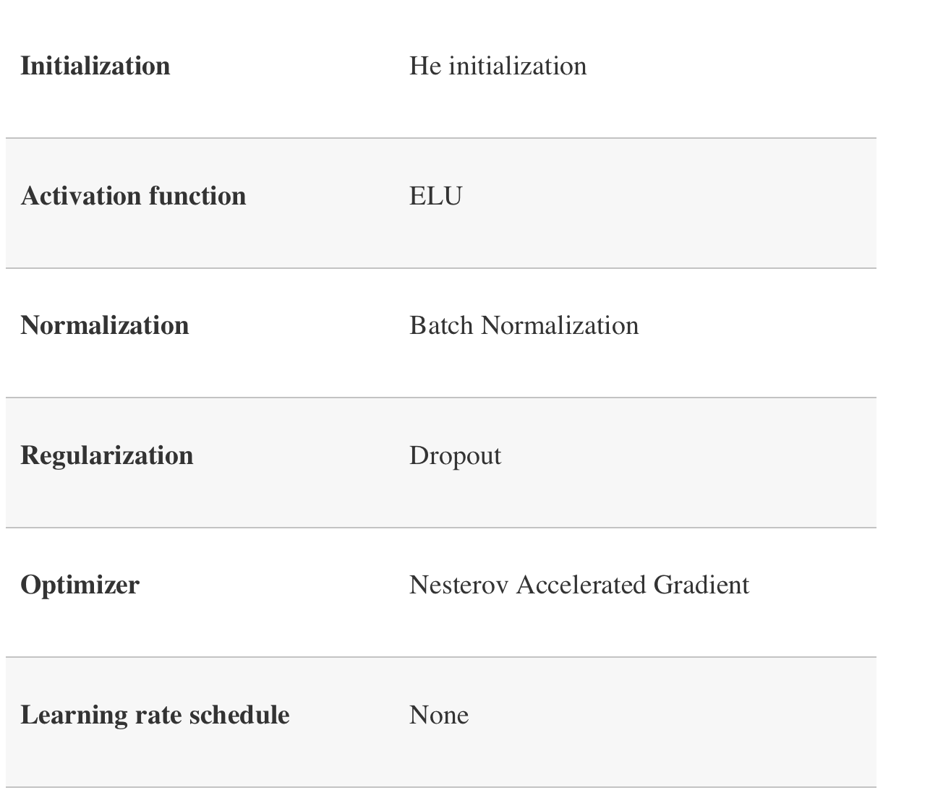
Practical Guidelines

